Slide 1
Donnybrook: Enabling Large-Scale, High-Speed, Peer-to-Peer Games
Ashwin Bharambe, John R. Douceur, Jacob R. Lorch, Thomas Moscibroda, Jeffrey Pang, Srinivasan Seshan, Xinyu Zhuang
Carnegie Mellon University, Microsoft Research
SigComm 2008

Slide 2
The Problem
To improve the scalability of high-speed online games using P2P approach.
Issues to be addressed:
  Estimate what players are paying attention to
  Handle resource and interest heterogeneity

Slide 3






Background: P2P
Local View
Replica objects
Internet
Primary object
Notes:
To understand why this is hard, lets consider an example. In peer-to-peer games, the objects in the game such as player avatars are hosted on the peers themselves. Sometimes one peer acts as a server and hosts all the objects but we’re going to look at the case when each peer hosts its own player to leverage all peers’ bandwidth resources.
Each peer sends updates about its object to all others so that everyone can create a replica and render the current view.

Slide 4


Background: High-Speed
Local View
Replica objects
Internet
Primary object
Inter-object writes
must be reflected
very quickly
Notes:
In high-speed games, interactions between objects, such as when one player shoots another, must be reflected very quickly, otherwise the game is no longer fun.

Slide 5
Background: High-Speed
Local View
Replica objects
Internet
Primary object
20 updates/sec
≈ 16 kbps per player
Delay must be < 150ms
[Beigbeder ‘04]
Notes:
This implies that each peer must send updates very frequently so that when interactions occur, they appear consistently for the players involved. In practice, updates for FPS games are sent each game frame or 20 times per second and must be delivered within 150 milliseconds or else their staleness degrades the game play experience.

Slide 6
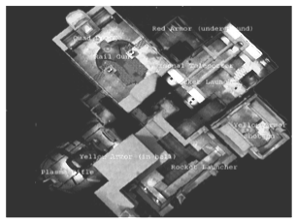
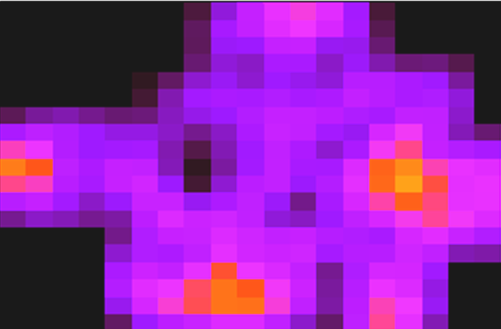

Motivation
Area-of-Interest (AOI) Filtering: only receive updates from players in your AOI
  Colyseus [Bharambe ‘06]
  VON [Hu ‘06]
  SimMUD [Knutsson ’04]
Problems:
  Open-area maps, large battles
  Region populations naturally follow a power-law
  [Bharambe ‘06, Pittman ‘07]
Quake 3 region popularity
Low population
High population
Notes:
Previous work has tried to address this problem by using area-of-interest filtering. Some game worlds can be partitioned into different regions and players only need to receive updates from others in the same region, such as those that are currently visible. However, area-of-interest filtering can not help when the map can not be partitioned or when game developers want to engineer a large scale game event such as a large battle.
Furthermore, it has been shown that even in maps that are partitioned, the population in different regions follows a power-law. Thus, if there are 1000s or 10s of thousands of players in the game, it is still likely that there are about 1000 players in a single region.

Slide 7

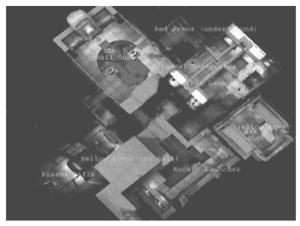



Approach: Interest Sets
Intuition: A human can only focus on a constant number of objects at once
  Only need a constant number of high-accuracy replicas
Interest Set: The 5 players that I am most interested in
  Subscribe to these players to receive 20 updates/sec
  Only get 1 update/sec from everyone else
My Interest Set
Me
Notes:
The intuition behind interest sets is that even when many players are visible, a human can only focus on a constant number of them at once. Thus, we should only need to have high-accuracy replicas of these objects.
We define my interest set as the five other players that I am most interested in. I subscribe to these players to receive frequent updates from them, while they receive only 1 update per second from everyone else. Other players replicas use guidable AI.

Slide 8
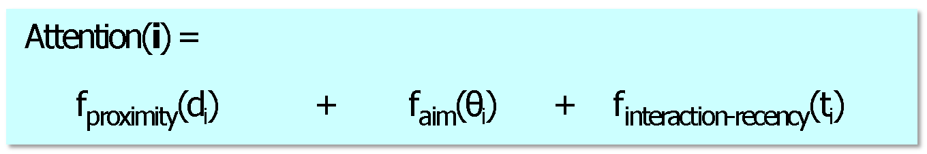
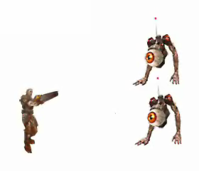


Approach: Interest Sets
How to estimate human attention?
  Attention(i) = how much I am focused on player i
θ₁
θ₂
d₁
d₂
Player 1
Player 2
Notes:
How does the game estimate what I am paying attention to?
We leverage the fact that several measurable metrics are often heavily correlated with attention in first person shooter games and compute attention as a weighted sum of these metrics:
-Proximity, because I am more likely to focus on players closer to me
Aim, because I am more likely to focus on players I am aiming at
And interaction-recentcy, because I am more likely to focus on a player I interacted with recently, such as if I shot them recently
We found that these simple metrics were a fairly good indicator of player focus in Quake III

Slide 9





Approach: Update Dissemination
Forwarding Pool
Well connected peers join forwarding pool
  Based on relative bandwidth and latency thresholds
These nodes advertise their forwarding capacity
  Piggy-backed on low freq. updates
Sources randomly pick enough forwarders to satisfy needs each frame
  Avoids need for coordination
  Fixed tree depth to bound delay
6Mbps
1Mbps
Frame #1
128kbps
512kbps
Randomized source-initiated tree construction
Notes:
Instead, we take the following approach:
We have well connected peers join a forwarding pool. Nodes detect locally whether they are a member of this pool using relative bandwidth and latency thresholds. These nodes advertise spare capacity to others. These advertisements are piggybacked on low frequency updates which recall are sent once per second.
Finally, when a low bandwidth node needs extra bandwidth to send its updates, it randomly picks enough forwarders in this pool to satisfy its needs.

Slide 10
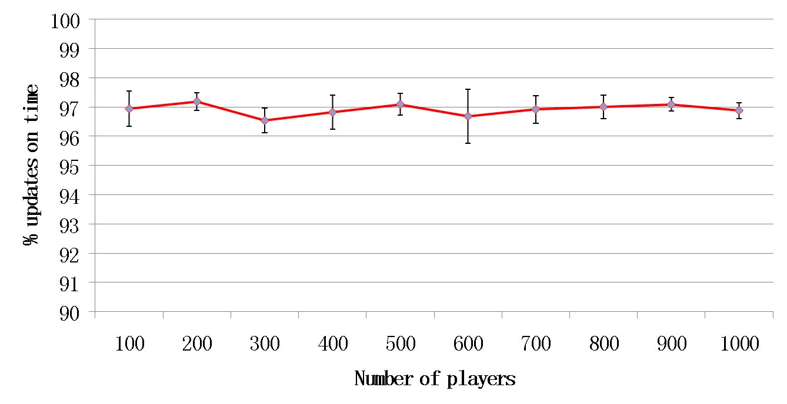
Results
Updates Received
Updates Required
Enough updates are delivered on time at all scales
Notes:
Here we show the percentage of updates that were received on time, averaged across several trials, as we increase the number of players in the game. Error bars show 95 percentile confidence intervals. The gray line shows the percentage of updates we want in order to preserve fun game play. We see that the red line is always above the grey line, so enough updates are delivered on time at all scales up to 1000 players.

